Slide 1

Linux 101
CIS 5930 / 4930
Offensive Security
Spring 2013

Slide 2
Today's talk
We're focusing on basics that are important for security work
OS basics
Kernel vs user space
root, and users;
permissions
file system (ext)
common commands
persistence mechanisms used by malware
and where logs occur
including SE linux
Today's talk is mostly going to be Debian-centric

Slide 3
But first... CVE-2013-0156 and CVE-2013-0155
On Jan 8th a CVE (Vulnerability notice) was issued for Ruby on Rails. Allowed attackers to:
Bypass Authentication systems
Inject Arbitrary SQL
Perform a Denial of Service (DoS)
Execute arbitrary code
On Jan 9th, public exploit code was released by someone else:
http://ronin-ruby.github.com/blog/2013/01/09/rails-pocs.html
This is how fast this industry moves. We're also hours away from it being implemented as an exploit in Metasploit:
https://community.rapid7.com/community/metasploit/blog/2013/01/09/serialization-mischief-in-ruby-land-cve-2013-0156?x=1

Slide 4
Lets revisit the disclosure debate
Lets consider some special cases in the debate
Anti Disclosure / Full Disclosure / Coordinated Disclosure / Delayed Disclosure / etc...
SCADA / PLC and forever days
serious problem for public safety and national security
also what about aircraft/FAA systems?
Medical systems (pacemakers?)
Self driving vehicles (in the future!)

Slide 5
Starter tips / Basic help
When in doubt:
consult the man pages
find the file or program you are looking for via:
find / -name "target file"
Program acting weird?
make sure it is the right program:
which "program"

Slide 6
Linux is everywhere
Desktops, tablets, laptops
routers
mobile (android)
TV's
Home Appliances
firewalls
probably weapons systems, missiles, etc...
probably in UAV drones
satellites
many, if not most webservers
etc...

Slide 7
What is an operating system?
Its an interface to the hardware, for users.

Slide 8
What happens when a system boots
The PC's power supply brings all the required voltages for the Motherboard and peripheral components to acceptable levels
+ & - 12V lines, + and - 5.00V, and likely + & - 3.30V
Once a good voltage is present, the Motherboard will turn on and fans will start spinning (can take half a second)
The motherboard's clock pulses begin synchronizing all interactions of the peripherals
RAM will be clear*

Slide 9
What happens when a system boots
Non-volatile ram may not be clear
The processor points to the start of the BIOS boot program (usually 0xFFFF0), right at the end of the system memory.
this usually is just a jump instruction
The BIOS performs the power-on self test (POST), and if there are any fatal errors, the boot processor stops

Slide 10
What happens when a system boots
The BIOS then looks for the video card (specifically the video card's own BIOS code which is usually at 0xC000 (C-thousand))
If any other BIOSes are detected (secondary, etc) they are executed as well...
what could go wrong? :)
Video cards can have non-volatile ram
Rootkits *can* hide here (very rare)
The BIOS then looks for any other devices ROM to see if they have BIOSes as well..
IDE/ATA hard disk BIOSes are usually at 0xC8000
Infecting these BIOS requires supply chain attack

Slide 11
What happens when a system boots
The BIOS then displays its startup screen
BIOS tests the system memory (RAM count)
BIOS then does hardware probing to detect what sorts of hardware is plugged in
BIOS then will detect & configure Plug & Play
BIOS then displays a summary screen, and then proceeds to look for a drive to boot from
BIOS looks for main boot record (MBR) to start the OS boot process.
There are MBR viruses
If it is on a HD then it looks for master boot record at cylinder 0, head 0, sector 1

Slide 12
The BIOS
Is the ultimate authority of what hardware is and is not installed on a system.

Slide 13
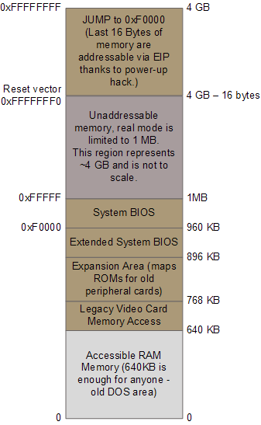
Boot Memory Diagram
Important memory
regions during boot
source: http://duartes.org/gustavo/blog/post/2008/06

Slide 14
Linux boot up
Boot loader (i.e. GRUB, LILO), then presents the boot options
calls start_kernel() on the selected option
start_kernel() performs most of the system setup
interrupt handling, memory manager, device initialization, drivers
start_kernel() spawns the idle process, process scheduler, and the init process (which is in userspace)

Slide 15

The Kernel
Handles all operating system
processes
memory management,
task scheduling (context switching)
I/O (and CPU interrupts, per packet, keystroke, etc...)
interprocess communication
and overall system control
Kernel is typically loaded as an image file, compressed into either zImage or bzImage formats (using zlib).
Linux has a monolithic kernel

Slide 16
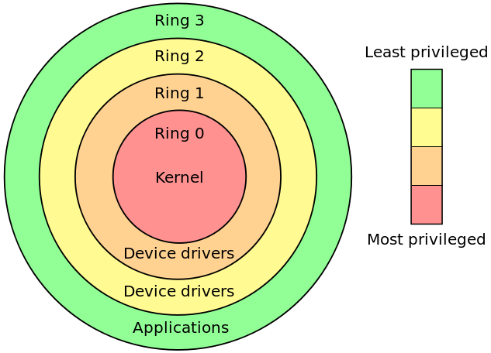
The Rings security Model
For fault tolerance, and security
Provide different levels of access
things operate above ring 0
SMM (System Management Mode) on intel chips
SMM rootkits: http://invisiblethingslab.com/resources/misc09/smm_cache_fun.pdf
BIOS
This is commonly referred to
with rootkits
this model is the opposite of
capability-based security

Slide 17
Kernel space
Where most device drivers run (@ ring 1-2)
Note that modern micro-kernel trends are pushing drivers into userspace.
Much different from user space
A crash here can be fatal
random number generation is very difficult
mistakes are unforgiving

Slide 18
Kernel modification
Modifying the kernel requires recompiling it, and rebooting from the new kernel to use it
unless ksplice or kexec are used
Mistakes are fatal
Difficult to use this in attack chain

Slide 19
init process (user space, ring 3)
Init is the father of all processes
it establishes and operates the entire user space
takes a parameter: runlevel (from 1 to 6)
run level determines which subsystems are run
Executes:
scripts to set up all non-operating system services and structures for the user environment
checks and mounts the file system
spawns the gui (if configured to)
Then presents the user with the login screen

Slide 20
init process (user space), cont
init scripts are located usually in directories such as:
/etc/rc....../
The toplevel configuration file for init is at /etc/inittab
Init checks for the runlevel parameter in /etc/inittab as well.

Slide 21
init process (user space), cont..
init goes dormant after all of the specified processes have been spawned
waits for 3 things to happen:
a process init has started is ending / dying
a power failure signal
or a request to /sbin/telnit to change the run level
There are other init alternative binaries (depending on the system), such as systemd, or upstart

Slide 22
User space
More security layers here.
root is king
common to have a single user account per service (apache's httpd, mysqld)
can be set to no login
The least privilege principle...

Slide 23

File system, deleting files
Deleting files can work somewhat like this (on hard disk).
Data gets left on the disk, and the inode is just unlinked,
so sectors usually have old data from other files in them->
unless securely deleted

Slide 24
File system basics ( ext2/ext3.. ufs, ffs, and others derived from the original fast file system (ffs)
Directory Entry
File Name Inode
(memory)
Inode (index node)
contains permissions, ownership info, timestamps, and other metadata
Accessed Time Size ..... UID GID
(memory or disk)
Blk 1 Blk 2 ... Indirect Blk 1
there are fifteen 4K sized block pointers per inode usually
(disk)
File Content
File Content
File Content
Indirect block (contains addresses of more blocks)
File Content

Slide 25
File system basics ( ext2/ext3.. ufs, ffs, and others derived from the original fast file system (ffs)
Directory Entry
Other Directory Entry
File Name X Inode
File Name Y Inode
Inode (index node)
....Meta Data....
Accessed Time Size ..... UID GID
(memory or disk)
Blk 1 Blk 2 ... Indirect Blk 1
there are fifteen 4K sized block pointers per inode usually
(disk)
File Content
File Content
File Content
Indirect block (contains addresses of more blocks)
File Content

Slide 26
General delete behavior (can differ per file system!!!)
Directory Entry
File Name Inode
The inode gets "unlinked"
The inode on disk will remain, and be marked for garbage collection. Memory inode will go away
Inode (index node)
Accessed Time Size ..... UID GID
Blk 1 Blk 2 ... Indirect Blk 1
(memory or disk)
there are fifteen 4K sized block pointers per inode usually
(disk)
File Content
File Content
File Content
Indirect block (contains addresses of more blocks)
File Content
Data remains on disk, and is available for the file system's automated garbage collection (can happen at any time)

Slide 27
General delete behavior (can differ per file system!!!)
Directory Entry
The inode gets "unlinked"
Other Directory Entry
File Name X Inode
File Name Y Inode
Inode (index node)
....Meta Data....
Accessed Time Size ..... UID GID
(memory or disk)
Blk 1 Blk 2 ... Indirect Blk 1
there are fifteen 4K sized block pointers per inode usually
(disk)
File Content
File Content
File Content
Indirect block (contains addresses of more blocks)
File Content

Slide 28

Generic directory layout for linux distros
Can vary, and can be confusion per distro
Is not really standardized
Can be difficult at first to figure out where programs, icons, config files, and other stuff is
So lets go over the most interesting places:

Slide 29
Generic directory layout highlights
< / >
This is the root directory. This is where the Linux FS begins. Every other directory is under it. Do not confuse it with the root account, or the root account's home directory.
< /etc >
The config files for the Linux system. Most are text files and can be edited by hand

Slide 30
Generic directory layout highlights
< /bin > and < /usr/bin >
These directories contain most of the binaries (programs) for the system. The /bin directory contains the most important programs:
shells,
ls, grep
/usr/bin contains other applications for the users
No real clear distinction purpose-wise between the two.

Slide 31
Generic directory layout highlights
< /sbin > and < /usr/sbin >
Most system administration programs are here
< /usr >
Most user applications, their source code, pictures, docs, and other config files. /usr is the largest directory on a linux system.
< /lib>
The shared libraries (shared objects) for programs that are dynamically linked are stored here

Slide 32
Generic directory layout highlights
< /boot >
Boot info is stored here. The linux kernel is also kept here. The file vmlinuz is the kernel.
< /home >
Where all the users' home directories are. Every user has a directory under /home, and its usually where they store all their files.

Slide 33
Generic directory layout highlights
< /root >
The superuser's (root) home directory
< /var >
contains frequently changed variable data when the system is running. Also contains logs (/var/log), mail (/var/mail), and print info (/var/spool)
< /tmp >
scratch space for temporary files

Slide 34
Generic directory layout highlights
< /dev >
Contains all device info for the linux system.
Devices are treated like files in linux, and you can read/write to them just like files (for the most part).
< /mnt >
Used for mount points
HD's, USB's, CD-ROM's must be mounted to some directory in the FS tree before being used. Debian sometimes uses /cdrom instead of /mnt

Slide 35
Generic directory layout highlights
< /proc >
This is a special, and interesting directory.
/proc is actually a virtual directory, b/c it does not actually exist.
It contains info on:
the kernel
all processes info
Contains special files that permit access to the current configuration of the system.

Slide 36
Users and groups
File permissions are specified in terms of the permissions of
The file owner (self)
The file's group members (group / business)
and everyone else (other)
ls -l
chmod
-R recursive, ie include objects in subdirectories
-f force, forge ahead with all objects even if errors occur
-v verbose, show objects processed
chattr / lsattr
chown
chgrp

Slide 37
/etc/passwd and /etc/shadow
The /etc/passwd file contains users':
user id
password hash or info (usually not included in the etc/passwd file anymore...)
user identifier
group identifier *(also stored in /etc/group)
Gecos field (just user meta data)
the user's home directory path
the program that launches when the user logs in (i.e. their shell)
entries look like:
jsmith:x:1001:1000:Joe Smith,Room 1007,(234)555-8910,(234)555-0044,email:/home/jsmith:/bin/sh
/etc/shadow file usually contains the password hashes, and is only accessible to root

Slide 38
/etc/shadow
man 3 crypt (shows the encryption man page)
options are:
$1$: it uses MD5.
$5$: it uses SHA-256.
$6$: it uses SHA-512.
$2a$: it uses blowfish, not supported everywhere.
Otherwise it uses DES.
md5 no longer secure
default is DES based, with a 2 character salt string [a–zA–Z0–9./]
salt is used to perturb the hash, in one of 4096 ways

Slide 39
The least privilege principle
every process/user/program must be able to access only the information and resources that are necessary for its legitimate purpose
i.e. single no-login user accounts for services like httpd, msqld, etc...
jails
security in depth
Makes logs cleaner

Slide 40
chroot
The root directory (i.e. /) is stored within each process's entry in the process table. All the chroot() system call does is to change the location of the root directory for that process.
Is seen as an OS-level virtualization mechanism.
The result is called a "chroot jail"
can be easily broken. Nothing prevents a program from chrooting out of the jail typically...
see http://www.bpfh.net/simes/computing/chroot-break.html

Slide 41
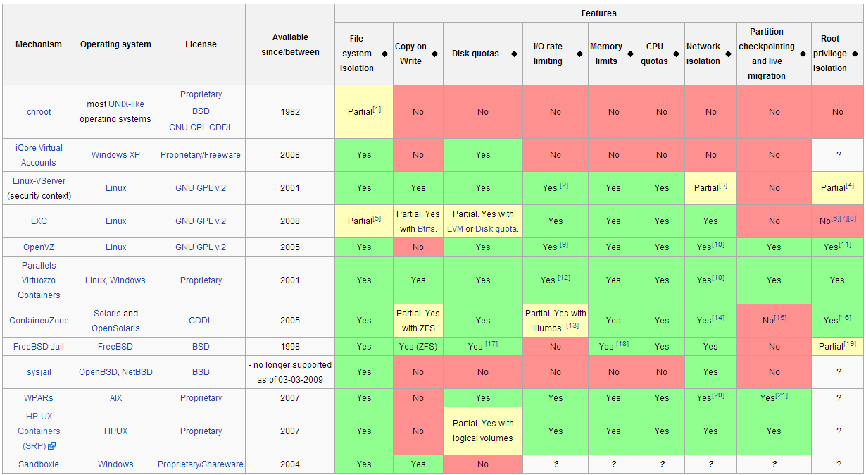
Existing OS level virtualizations
source: http://en.wikipedia.org/wiki/Jail_(computer_security)

Slide 42
File ownage and setuid setgid
Set User Id (upon execution) and Set Group ID (upon execution).
Are flags that allow a binary to be executed with the permissions of the binary's owner
Certain applications need to execute under other user account permissions
example: passwd
modified the /etc/passwd or /etc/shadow files which are owned by root.
Can't just let anyone edit this freely

Slide 43

setuid (as root) programs
these programs have complete access on a UNIX system
virtually every attack chain involves a focus on attacking these programs
they are the single points of failure
once attackers get any form of access, they want to escalate to root
find / -perm -4000 -print
will find all setuid programs

Slide 44
Some example results (ubuntu12.04)
/usr/sbin/uuidd
/usr/sbin/pppd
/usr/lib/openssh/ssh-keysign
/usr/lib/eject/dmcrypt-get-device
/usr/lib/dbus-1.0/dbus-daemon-launch-helper
/usr/lib/policykit-1/polkit-agent-helper-1
/usr/lib/pt_chown
/usr/lib/chromium-browser/chromium-browser-sandbox
/usr/bin/lppasswd
/usr/bin/sudo
/usr/bin/passwd
/usr/bin/chfn
/usr/bin/X
/usr/bin/pkexec
/usr/bin/arping
/usr/bin/mtr
/usr/bin/gpasswd
/usr/bin/newgrp
/usr/bin/at
/usr/bin/chsh
/usr/bin/traceroute6.iputils
/usr/bin/sudoedit
/sbin/mount.ecryptfs_private
/bin/su
/bin/ping6
/bin/fusermount
/bin/mount
/bin/ping
/bin/umount
This can all be seen as the attack surface for any permission escalation attacks
good source: http://www.acm.uiuc.edu/workshops/security/setuid.html

Slide 45
setuid and setgid on directories
entirely different
setuid in a directory:
does nothing! Is disabled on almost all unix systems
setgid on a directory:
new files and new subdirectories within inherit the directory's gid
instead of the creator's primary gid
enables shared workspaces for groups

Slide 46
Access Control Lists
Usually are disabled by default
Extendeds the owner/group/other access model to allow much finer control
can specify permissions for each individual user and group defined in the system
is a mount option that can be turned on for specific permissions in the /etc/fstab file
example entry in /etc/fstab:
UID=dfb1151a-be85-496f-8c3c-32804b947446 / ext4 errors=remount-ro,acl 0 1

Slide 47
Access Control Lists
On debian can then install ACL utilities
$ apt-get install acl
or use eiciel (a GUI based ACL manager)
Example use: Say we have a file "target.txt" that we want the following to be able to edit:
joe (the CEO)
developers-g (the developer's group)
qa-g (the quality assurance & testing group)

Slide 48
ACL Example
developers-g is the group owner for Target.txt
To enable ACL:
$ setfacl -m group:developers-g:rw- Target.txt
TO enable R/W perm for qa-g, and joe:
$setfacl -m group:qa-g:rw-,user:joe:rw- Target.txt
Pretty simple!!
Note: ls- l will not display the ACL of a file, only if an ACL is enabled by a + sign at the end of permissions. Example:
-rw-rw-r--+ 1 bob bob 60097 2013-01-01 10:55 Target.txt

Slide 49
Extended file attributes (xattr)
supported by ext2, ext3, ext4, JFS, ReiserFS, XFS, Btrfs, etc...
attr / lsattr / chattr interesting uses:
chattr +i = immutable (means no one, not even root can change/delete/link the file)
chattr +a = make file append-only (great for logs security!)
chattr +s = secure deletion for file
By default only root can use xattr, but can be enabled for all in /etc/fstab with the user_xattr option

Slide 50
tty
A TTY is a native terminal device (the backend is either kernel or hardware emulated)
named after TeleTYpewriter (TTY)
TTY ports are direct connections to the computer
i.e. keyboard, mouse, or serial connection
commands:
who - lists all users and their terminals
chvt - switch to another terminal (requires root)
no GUI (i.e. not the X environment)

Slide 51
pts
Pseudo Terminal Slave
Is a terminal emulated by another program
xterm, screen, ssh, expect, GNOME terminal, Mac OSX terminal....
is created through
Can switch terminals:
screen windowlist
BSD PTYs (obsolete)
Unix98 PTYs

Slide 52
Daemons
view them via "service" command
background processes
syslogd (system logging process)
sshd (ssh daemon for incoming ssh connections)
almost all daemons are spawned by init
standard behavior:
have no tty (controlling terminal)
ignore all terminal signals except SIGTERM
have no open file descriptors (no I/O)
dissassociated from process group

Slide 53
Kernel Modules
a Loadable Kernel Module (LKM) is an object file that contains code that extends the running kernel.
typically used to add support for new hardware, file systems, or adding system calls...
Convenient method for modifying the kernel
can be abused by attackers though...

Slide 54
cronjobs
cron is the time-based job schedule in Unix systems.
cron enables users to schedule jobs (commands or shell scripts) to run periodically or at certain times or dates
Commonly used to automate system maintenance or administration

Slide 55
Command history
can view previous commands:
history
can repeat previous commands:
!!
!ssh
can print the command instead of repeating it:
!ssh:p

Slide 56
logs
stored typically in /var/log/
messages - General log messages
auth.log, faillog, lastlog -authentication logs
boot.log - System boot log
syslog ( a log file and a C command)
daemon.log - running services such as ntpd, httpd, and etc logs
kern.log - kernel log file
mysql.log, mysql.err - database logs (different if postgres, mongo, or other DB)

Slide 57
logs continued
user.log (user level/application logs)
There are also virtual machine logs too
/var/log/apache2/ for apache2 logs
/var/log/snort/ for snort logs
and more....
There is a gui based log viewer for GNOME: gnome-system-log

Slide 58
logs are important to know about for attackers
brute force (i.e. ssh) attempts leave a big footprint
remote logins (ips/domains are logged)
system modification
kernel modification
module loading / unloading
daemon logs

Slide 59
Linux Firewalls (host based)
Modern Linux host-based firewalls rely on a kernel-based system called "netfilter"
the iptables user-space tool allows for managing netfilter
Netfilter:
is a framework within the linux kernel
has 3 standard tables: filter, nat, mangle
is primarily a connection-tracking system
does NOT filter traffic itself, it provides functions for other tools to do that

Slide 60
Netfilter framework tables
Filter - default and most basic
INPUT, OUTPUT, FORWARD chains
responsible for system protection
NAT
Network Address Translation
MASQUERADE usage allows for routing multiple private IP addr's through a single public IP addr.
Mangle
For changing certain packet fields prior to local delivery.

Slide 61
iptables
part of almost all linux distros since 2.4 kernel (2001)
tables, chains, matches, and targets
policies are built from an ordered set of rules
each rule is applied to a chain within a table
an iptables chain is a collection of rules that are compared, in order, against packets that share common characteristics (inbound packets vs outbound for instance.

Slide 62
iptables
Tables:
this is a construct that delineates a broad category of functionality
packet filtering, NAT, etc.
4 tables:
1) filter (for filtering rules)
2) nat (for nat rules)
3) mangle (for specialized rules)
4) raw (for rules that function independent of the Netfilter connection tracking subsystem)

Slide 63
iptables
Chains:
Each table has its own set of default chains
The most important built-in chains for us are the INPUT, OUTPUT, and FORWARD chains in the filter table
The INPUT chain used for packets destined for the local Linux system after routing calculations are done in kernel (i.e. addressed to local socket)
The OUTPUT chain is used for packets leaving the system
FORWARD chain governs packets routed through the system

Slide 64
iptables
Important chains in the NAT table:
PREROUTING
POSTROUTING
These are used to modify packet headers before and after IP routing calculations are made in kernel
Local Socket
User Space
Kernel Space
filter INPUT
filter OUTPUT
incoming packets
Routing Decision
filter FORWARD
outboundpackets
nat PREROUTING
nat POSTROUTING
figure source: Linux Firewalls, by Michael Rash

Slide 65
iptables
rule Matches:
Each rule has a set of matches, along with a target
Target tells iptables what to do with a packet that matches the rule

Slide 66
iptables
match examples
--source (-s) Match on source IP or network
--destination (-d) Match on dest IP or network
--protocol (-p) match on an IP value
--in-interface (-i) match on input interface (eth0)
--out-interface (-o) match on output interface (eth0)
--state match on a set of connection states
--string match on a sequence of application layer data bytes (not ASCII string...)
--comment a way to tag packets with a comment in the kernel

Slide 67
iptables
Targets:
when a packet matches a rule, the target (action) is triggered:
ACCEPT
DROP
LOG (logs a packet to syslog)
REJECT
RETURN (continues processing a packet within the calling chain)

Slide 68
iptables Policy Requirements
In general, a system or systems behind a firewall should be able to initiate the following through to firewall, to outside servers:
Domain Name System (DNS) queries
File Transfer Protocol (FTP) transfers
Network Time Protocol (NTP) queries
Secure SHell (SSH) queries
Simple Mail Transfer Protocol (SMTP) sessions
Web Sessions over HTTP/HTTPS
WHOIS queries
And in general, ALL other outbound traffic should be blocked

Slide 69
iptables Policy Requirements
Sessions initiated from the internal network should be statefully tracked by iptables
packets that do not conform to a valid state should be logged, and dropped
firewall should be configured with a default log and drop policy, to guard against any stray packets, port scans or unallowed connection attempts
perhaps block all incoming SSH traffic if applicable
We'll cover this more later... but the lesson here is: Firewalls are effective security defenses

Slide 70
ports and services
The /etc/services file contains network port names and numbers which can be used to determine firewall rules

Slide 71
What can go wrong if an attacker gets root
everything

Slide 72
Rootkits

Slide 73
Rootkits (i.e. game over man)
The most common ways linux rootkits install on systems are:
Loadable Kernel Modules (LKM)
Hooking
Direct Kernel Object Manipulation (DKOM)
Kernel Object Hooking
Run-Time Kernel Memory Patching

Slide 74
Loadable Kernel Modules
KLD = Kernel LoaDable object and LKM are synonymous
are .ko Object files that contains code to extend the kernel (ring 0)
Is the official way of modifying the kernel
driver code
most are located in /lib/modules
can disable via /proc/sys/kernel/modules_disabled
allows:
keylogging, backdoors, etc
Not stealthy

Slide 75
Hooking
Hooking is a programming technique that employs handler functions (called hooks) to modify control flow of a process.
New hook registers its address as the location for a specific function
when that function is called, the hook is run instead
Hooks are used by rootkits to alter the OS's application programming interface (API)
System calls are typical targets
enables keylogging, backdoors, etc...

Slide 76
Direct Kernel Object Manipulation (DKOM)
All OSes store internal record-keeping data within main memory.
these memory structures can be manipulated directly, without any need to install a call hook.
hide a process in the /proc structure or allproc list
hide open ports
attacks here can face synchronization issues (if kernel preempts before attack is done, crashes can happen)

Slide 77
Kernel Object Hooking
Very similar to DKOM, but just uses hooks instead of data-state changes
Devices are defined by their entries in device tables
i.e. character devices (keyboards) have entries in a thing called the character device switch table
Simply hook the device table
Boom
Nothing new here really

Slide 78
Run-Time Kernel Memory Patching
/dev/kmem device
allows read / write to kernel virtual memory
Allows attackers to patch various code bytes (loaded in executable memory space) that control the logic of the kernel
byte code
Example Algorithm
Retrieve the in-memory of the mkdir sys call
save sizeof(kmalloc) bytes of mkdir
overwrite mkdir with kmalloc (causes kernel panic)
call mkdir
restore mkdir

Slide 79
Sources
"Designing BSD Rootkits: An Introduction to Kernel Hacking" by Joseph Kong

Slide 80
Questions?

Slide 81
Homework 1
Out on the website.
Due Jan 24, hard copy, before class

